Slide 1
Maintainability Design II – Creational Design Patterns
CS 301: IT Solution Architecture
Week 5

Slide 2
Motivation
Problem: Sometimes we only ever need one instance of a particular class. We'd like to make it illegal to have more than one.
Creating lots of objects can take a lot of time. Extra objects take up memory. It is a pain to deal with different objects floating around if they are essentially the same.

Slide 3
Singleton

Slide 4
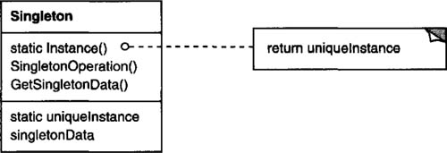
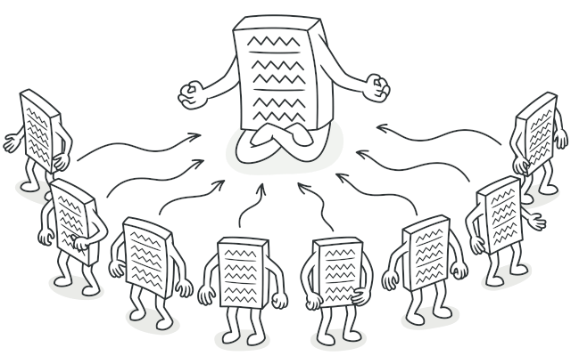
Pattern: Singleton
Intent
Ensure a class only has one instance
Provide a global point of access to it.
Notes:
https://refactoring.guru/design-patterns/singleton

Slide 5
Let’s assume a claims system
The claims application is meant for staff to login and submit a expense claim.
The expense claims form comprises of the staff personal details and common claim-related details.
The staff details are stored in centralized MSSQL DB while the claims details are stored in a MySQL DB used only by the claims application.
The expense claim request once submitted, is sent to the appropriate manager/head for approval.
For approved claims, a daily scheduler is configured to invoke the application to send these approved claims to SAP system.
On a monthly basis, staff with managerial role is able to generate claims reports of their staff.

Slide 6
Scenario - Singleton
Scenario : To display/submit the claim, the claim type (e.g. Transport) has to be retrieved. However, only the short name (e.g. TR) is stored with the claim and the full value has to be lookup (e.g. lookup name-TR to retrieve value-Transport) in the database.
The database calls are being invoked for every call and you realise that these lookup values can be cached in memory. You implement a cache but realised you should have only a single instance of this cache object to minimise expensive database calls.
public class ClaimsForm {
public void displayClaimsForm() {
Cache = new Cache();
cache.lookupValue("TR");
}
}
public class Cache {
Map<String, String> lookupValues =
new HashMap<String, String>();
public Cache () {
// read from DB and put into map
lookupValues.put("TR","Transport");
}
public String lookupValue(String name) {
return lookupValues.get(name);
}
}
public class ClaimsReport {
public void displayClaimsReport() {
Cache cache = new Cache();
cache.lookupValue("TR");
}
}
* Different box colours refers to different coders

Slide 7
Singleton Implementation
“….. one instance… a global point of access to it……”
Make constructor(s) private so that they can not be called from outside
Declare a single static private instance of the class
Write a public getInstance() or similar method that allows access to the single instance

Slide 8
Singleton Implementation
public class Cache {
Map<String, String> lookupValues =
new HashMap<String, String>();
private Cache() {
//read from DB and put into map
lookupValues.put("TR","Transport");
}
private static final Cache
INSTANCE = new Cache();
public static Cache getCache() {
return Cache.INSTANCE;
}
public String lookupValue(String name) {
return lookupValues.get(name);
}
}
public class ClaimsForm {
public void displayClaimsForm() {
Cache cache = Cache.getCache();
cache.lookupValue("TR");
}
}
3
1
2
public class ClaimsReport {
public void displayClaimsReport() {
Cache cache = Cache.getCache();
cache.lookupValue("TR");
}
}
3
3
Can this design be improved?
Notes:
Think along the line
Will the data be modifiable elsewhere?
Can we delay the memory usage till really required?

Slide 9
Motivation
Problem: Imagine a complex object that requires laborious, step-by-step initialization of many fields and nested objects.
Such initialization code is usually buried inside a monstrous constructor with lots of parameters. Or even worse: scattered all over the client code.

Slide 10
Builder

Slide 11
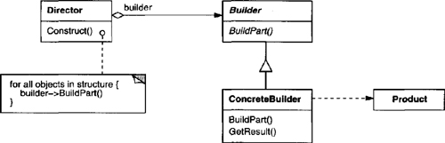
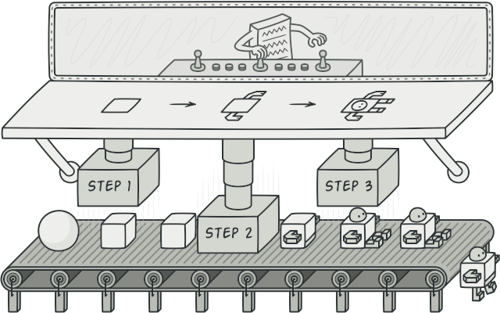
Pattern: Builder
Intent
Separate the construction of a complex object step by step and allows the same construction process to create different representations.

Slide 12
Let’s assume a claims system
The claims application is meant for staff to login and submit a expense claim.
The expense claims form comprises of the staff personal details and claim items details.
The staff details are stored in centralized MSSQL DB while the claims details are stored in a MySQL DB used only by the claims application.
The expense claim request once submitted, is sent to the appropriate manager/head for approval.
For approved claims, a daily scheduler is configured to invoke the application to send these approved claims to SAP system.
On a monthly basis, staff with managerial role is able to generate claims reports of their staff.

Slide 13
Scenario - Builder
Scenario : When the staff login, you need to instantiate the staff object and it comprise of many initialization parameters.
public class Staff {
private final String lastName;
private final String firstName;
private final String middleName;
private final String addressBlock;
private final String addressStreet;
private final String addressUnit;
private final String addressCity;
private final int addressPostalCode;
private final boolean isEmployed;
//assume constructor, getters and setters
// methods for the above variables
}
public class Login {
public Staff constructUser() {
//assume read from DB
return new Staff("Ouh", "", "Eng Lieh", "80",
"Stamford Road", "5036", "Singapore", 178902, true);
}
}
The number of parameters can keep increasing, can this design be handled better?
You also realise you need to design a guest login soon.
Notes:
Think along the line
- What are the possible mistakes a developer can make when there are too many parameters to call

Slide 14
Builder Implementation
“…construction of a complex object …. same construction process can create different representations (products)….”
Encapsulate, create, and assemble the parts of a complex object in a separate Builder object.
Delegate the object creation to a Builder object instead of creating the objects directly.

Slide 15
Builder Implementation
public interface UserBuilder { // Builder
void buildName(NameBuilder nameBuilder);
void buildAddress(AddressBuilder addressBuilder);
User getUser();
}
public class StaffBuilder implements UserBuilder {
private User ;
public StaffBuilder(boolean isEmployed) {
user = new User(isEmployed);
}
// setter methods for the abstract methods
}
public class GuestBuilder implements UserBuilder {
private User ;
public GuestBuilder() {
user = new User(false);
}
// setter methods for the abstract methods
}
class User { // Product
private NameBuilder ;
private AddressBuilder ;
private boolean isEmployed;
// assume constructor and setter methods
}
class NameBuilder {
private String lastName;
private String firstName;
private String middleName;
// assume constructor and setter methods
}
class AddressBuilder {
private final String addressBlock;
private final String addressStreet;
private final String addressUnit;
private final String addressCity;
private final int addressPostalCode;
// assume constructor and setter methods
}
1
1
1
NameBuilder nameBuilder = new NameBuilder("Ouh", "Eng Lieh“, "");
AddressBuilder addressBuilder =
new AddressBuilder("80", "Stamford Road", "5036", "Singapore", 178902);
StaffBuilder staff = new StaffBuilder(true);
staff.buildName(nameBuilder);
staff.buildAddress(addressBuilder);
return staff.getUser();
2

Slide 16
Motivation
Problem: Imagine you have an existing class to return a specific product. Subsequently, you need to extend this class to return other products within the same family. You create more and more classes to return these products.
As a result, the caller of your codes end up with pretty nasty code as it goes on, riddled with specific codes (new keyword) to instantiate the required products. This design tightly coupled your codes with the callers.
Notes:
https://refactoring.guru/design-patterns/factory-method

Slide 17
Factory

Slide 18
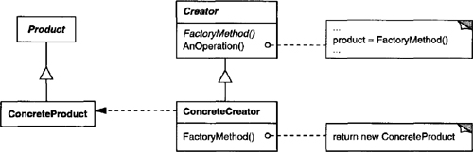
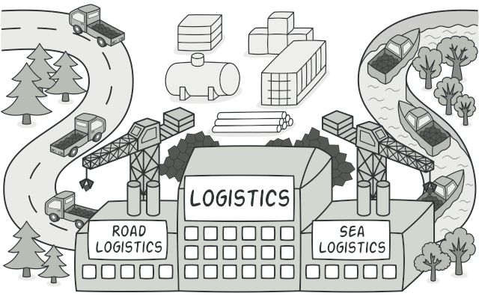
Pattern: Factory Method
Intent
Define an interface for creating an object, but let subclasses decide which class to instantiate.
Factory Method lets a class defer instantiation to subclasses.
Notes:
https://refactoring.guru/design-patterns/factory-method

Slide 19
Let’s assume a claims system
The claims application is meant for staff to login and submit a expense claim.
The expense claims form comprises of the staff personal details and claim items details.
The staff details are stored in centralized MSSQL DB while the claims details are stored in a MySQL DB used only by the claims application.
The expense claim request once submitted, is sent to the appropriate manager/head for approval.
For approved claims, a daily scheduler is configured to invoke the application to send these approved claims to SAP system.
On a monthly basis, staff with managerial role is able to generate claims reports of their staff.

Slide 20
Scenario – Factory Method
Scenario : To generate the claims report, you need to select data from tables in MSSQL and MySQL DBs.
public class MSSQLTable {
public boolean select() {
System.out.println
("MSSQLTable::select() was called.");
return true;
}
}
public class MySQLTable {
public boolean select() {
System.out.println
("MySQLTable::select() was called.");
return true;
}
}
public class ClaimsReport {
public void retrievePersonalDetails() {
MSSQLTable s1 = new MSSQLTable();
s1.select();
}
public void retrieveClaimsDetails() {
MySQLTable s2 = new MySQLTable();
s2.select();
}
}
* Assume the right green box is a different coder
Notes:
Think along the line of
One of the SOLID principle
There are two coders involved (potentially between vendors or teams), what is the implications of this design?

Slide 21
Factory Method Implementation
“….defer instantiation to subclasses…”
Create an interface of the product.
Create concrete classes implementing the product interface.
Create an interface of the creator (factory) class
Create a concrete class implementing the creator interface

Slide 22
Simple Factory Method Implementation
Scenario : You need to select data from table in MSSQL and MySQL DBs
public interface TableFactory { // Creator
public Table getTable(DatabaseType type);
}
public class ATableFactory implements TableFactory {
public Table getTable(DatabaseType type) {
if (type == DatabaseType.MySQL) {
return new MySQLTable();
} else if (type == DatabaseType.MSSQL) {
return new MSSQLTable();
} else {
return null;
}
}
}
public interface Table { // Product
public boolean select();
}
public class MSSQLTable implements Table {
public boolean select() {
// same as before
}
}
public class MySQLTable implements Table {
public boolean select() {
//same as earlier
}
}
3
1
4
2
2
public class ClaimsReport {
TableFactory tFactory = new ATableFactory();
public void retrievePersonalDetails() {
Table t = tFactory.getTable(DatabaseType.MSSQL);
t.select();
}
public void retrieveClaimsDetails() {
Table t = tFactory.getTable(DatabaseType.MySQL);
t.select();
}
}
4
Can this design be improved?
Notes:
Think along the line of
- SOLID principles

Slide 23
Factory Method Implementation
Scenario : You need to select data from table in MSSQL and MySQL DBs
public interface Table {
public boolean create();
}
public class MSSQLTable implements Table{
public boolean select() {
//same as earlier
}
}
public class MySQLTable implements Table{
public boolean select() {
//same as earlier
}
}
public interface TableFactory {
public Table getTable();
}
public class MSSQLTableFactory implements TableFactory {
public Table getTable() {
return new MSSQLTable();
}
}
public class MySQLTableFactory implements TableFactory {
public Table getTable() {
return new MySQLTable();
}
}
1
3
2
4
4
2
public class ClaimsReport {
public void retrievePersonalDetails() {
TableFactory tFactory = new MSSQLTableFactory();
tFactory.getTable().select();
}
public void retrieveClaimsDetails() {
TableFactory tFactory = new MySQLTableFactory();
tFactory.getTable().select();
}
}
MSSQLTable Factory
MSSQLTable
4
Table Factory
MySQLTable Factory
MySQLTable

Slide 24
Exercise
Creational Design Patterns

Slide 25
Gang of Four (GoF) patterns
Creational Patterns (abstracting the object-instantiation process)
Factory Method Abstract Factory Singleton
Builder Prototype
Structural Patterns (how objects/classes can be combined to form larger structures)
Adapter Bridge Composite
Decorator Facade Flyweight
Proxy
Behavioral Patterns (communication between objects)
Command Interpreter Iterator
Mediator Observer State
Strategy Chain of Responsibility Visitor
Template Method Momento

